Slide 1
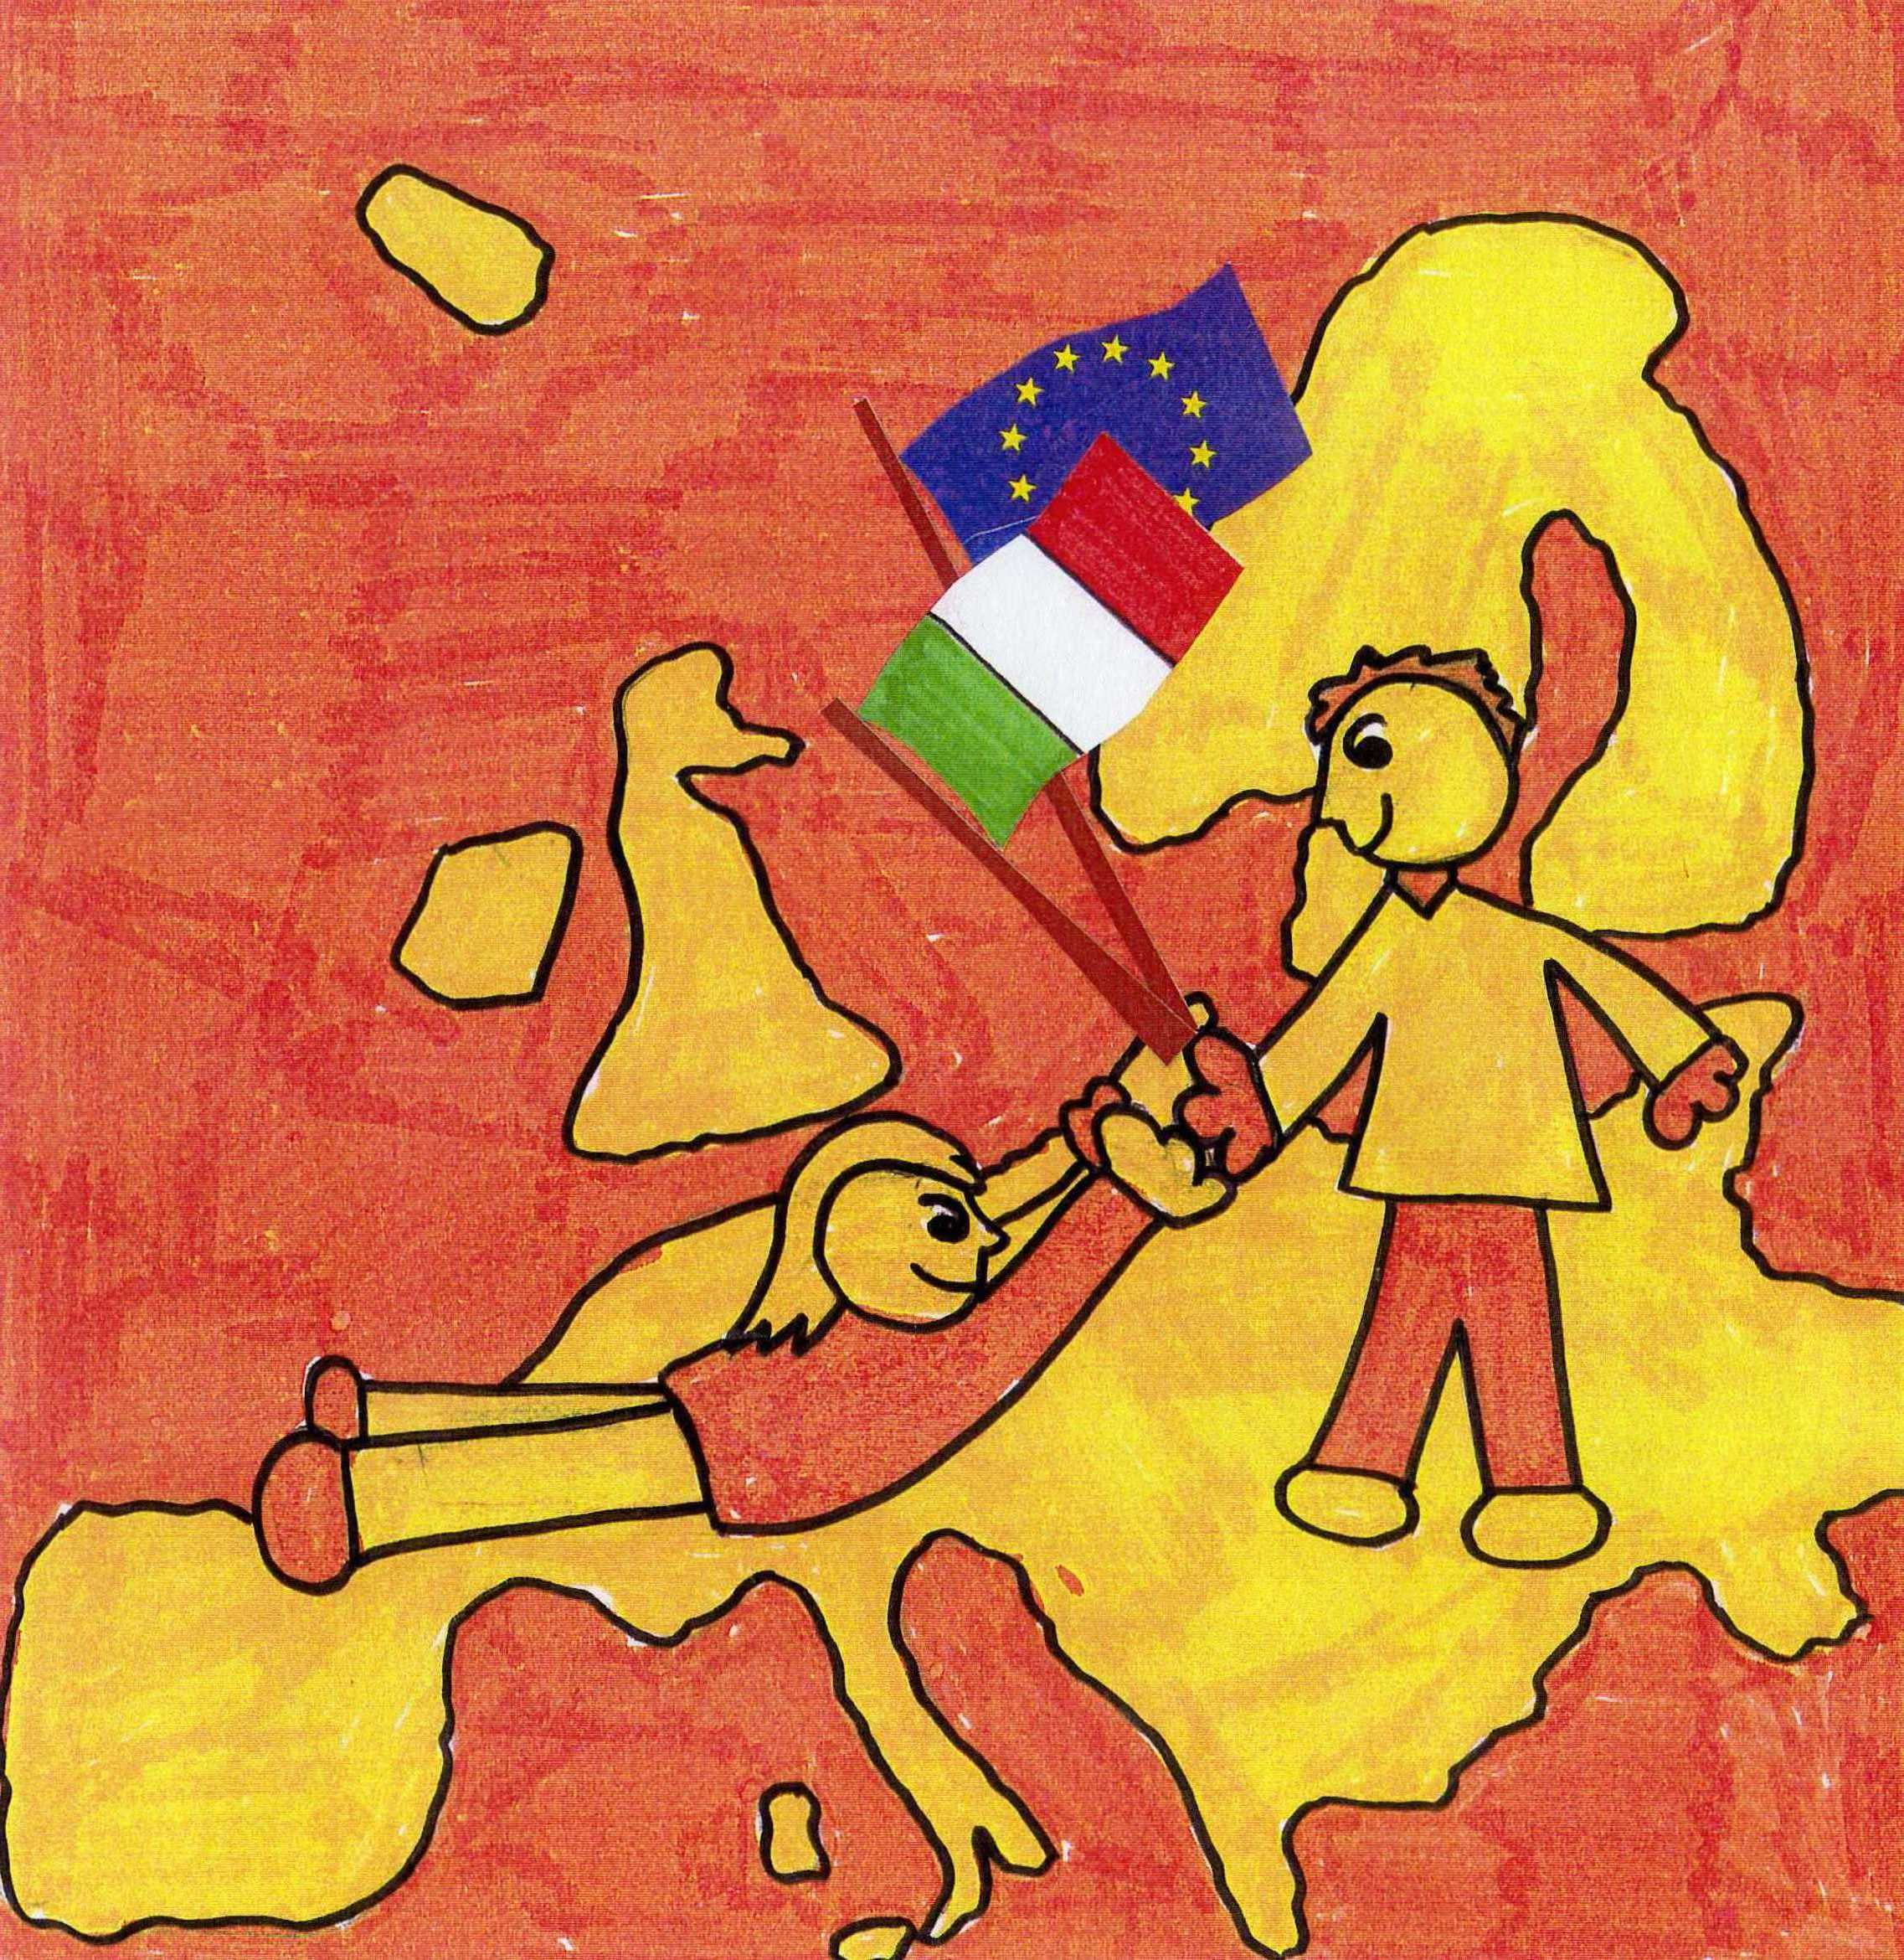

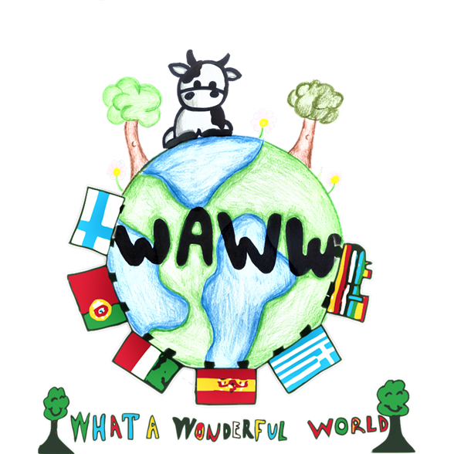
ISTITUTO
COMPRENSIVO ADELE ZARA
Oriago di Mira VENICE
Welcome to Italy!!!

Slide 2
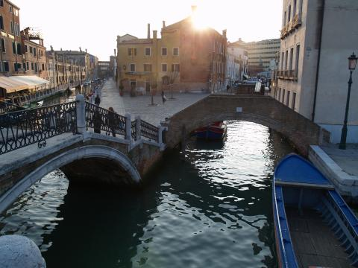
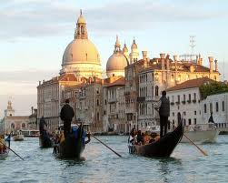
VENICE, a city on the water
We live near Venice a very special city, on a group of islands surrounded by water .
It is really unique, the only one of its kind in all the world.

Slide 3
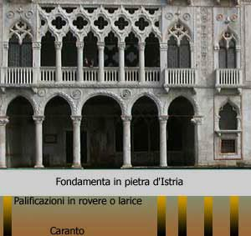
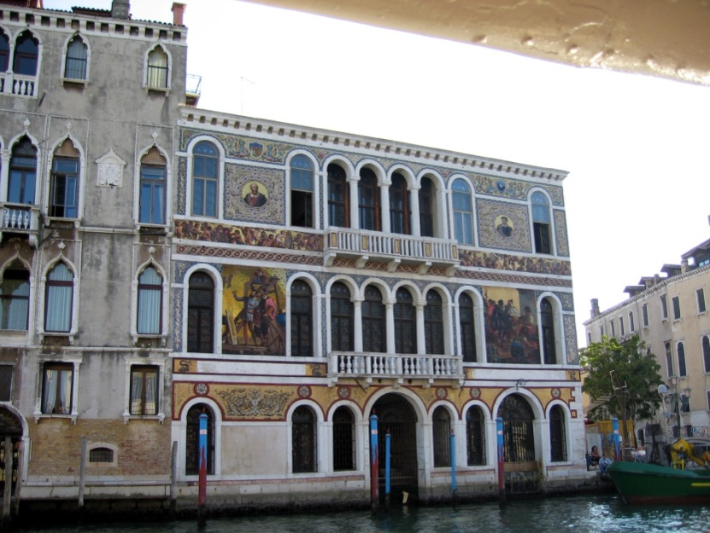
In the past
Venetians built several
rafts of various sizes,
supported by wooden
poles that were fixed
to the sand.
In this way
they could build
on them palaces,
buildings and monuments.
.

Slide 4
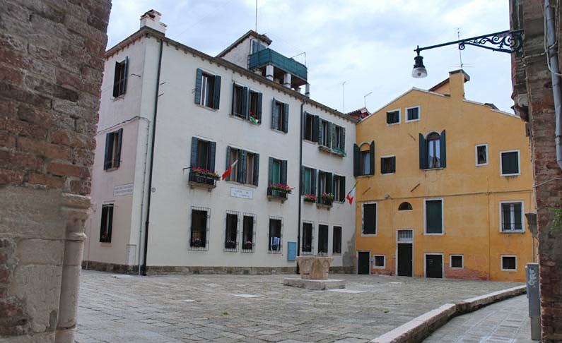

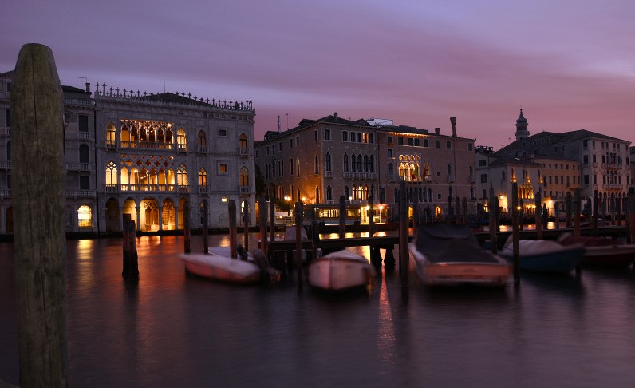
Corte de
Le candele
Riva de l’Ogio

Slide 5
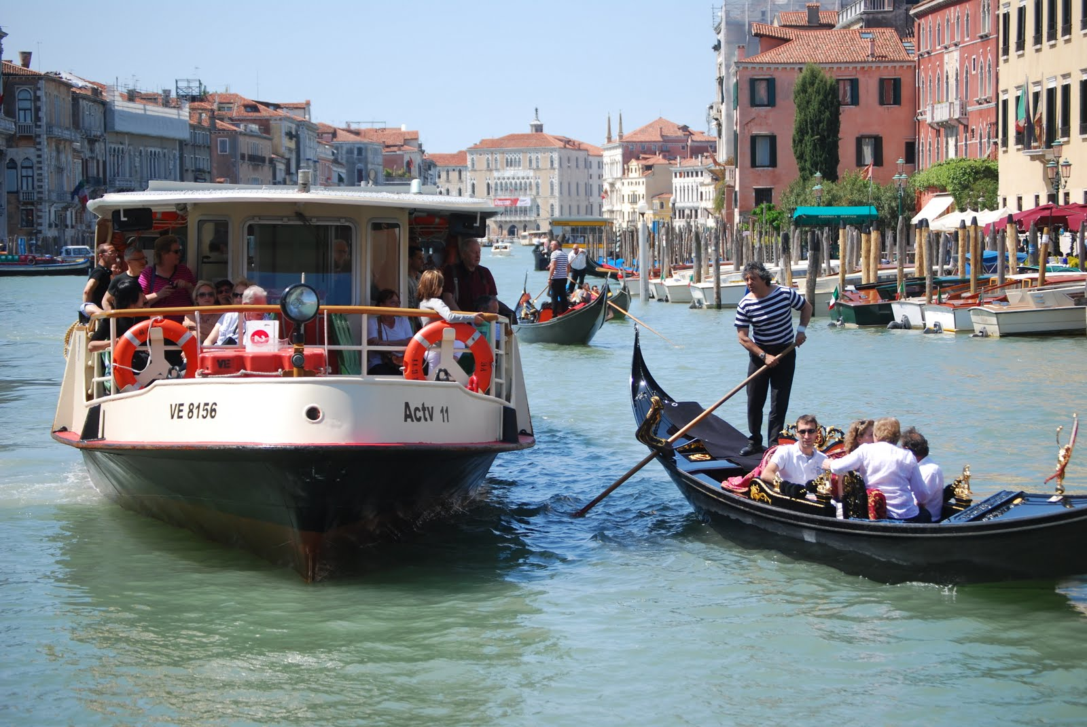
No streets in Venice! Do you know that?
There are just canals and so… there are no cars.
You can walk on sidewalks, but to really get around and enjoy your visit , you need a boat.
You can choose: a vaporetto – it is like a "water bus" - or a gondola, a boat with only one oar.

Slide 6
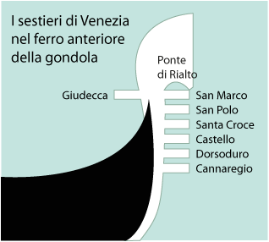
The symbols THE GONDOLA
Every detail has got a special meaning.
There is a kind of comb
with six teeth or prongs (called rebbi) standing for the six sestieri of Venice:
San Marco
San Polo
Santa Croce
Castello
Dorsoduro
Cannaregio

Slide 7
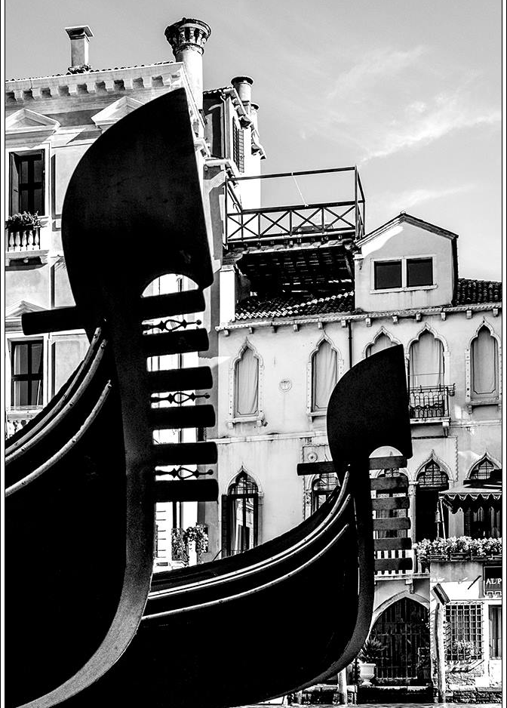
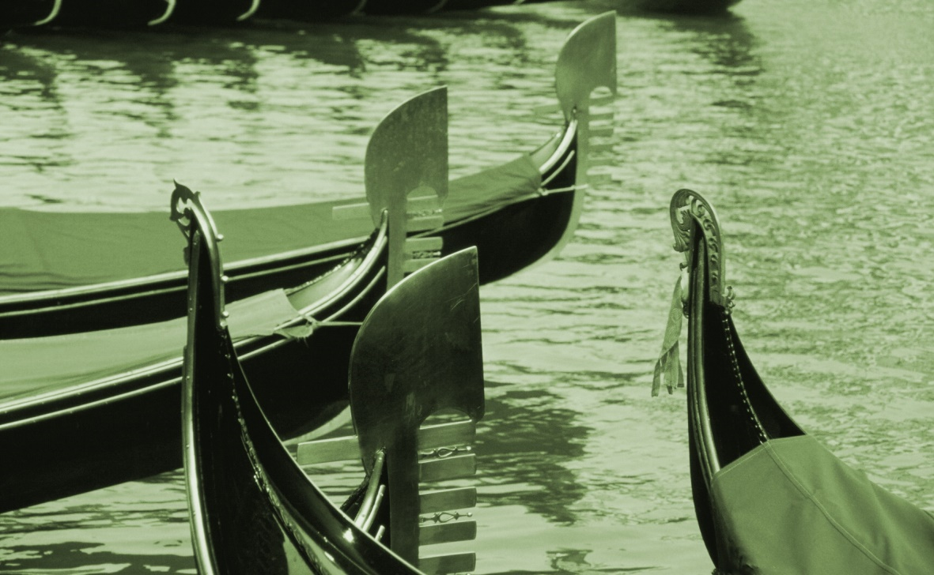
The GONDOLA , a unique boat

Slide 8
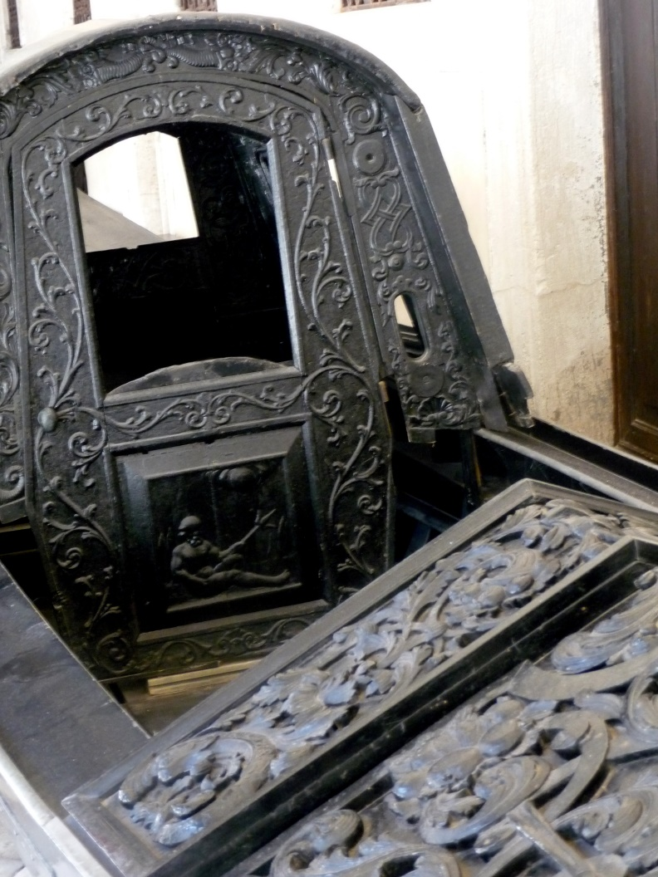

The gondola is a traditional rowing boat, designed for the unique conditions of the Venetian Lagoon.
It is almost 11 metres long and weighs 600 kilos.

Slide 9
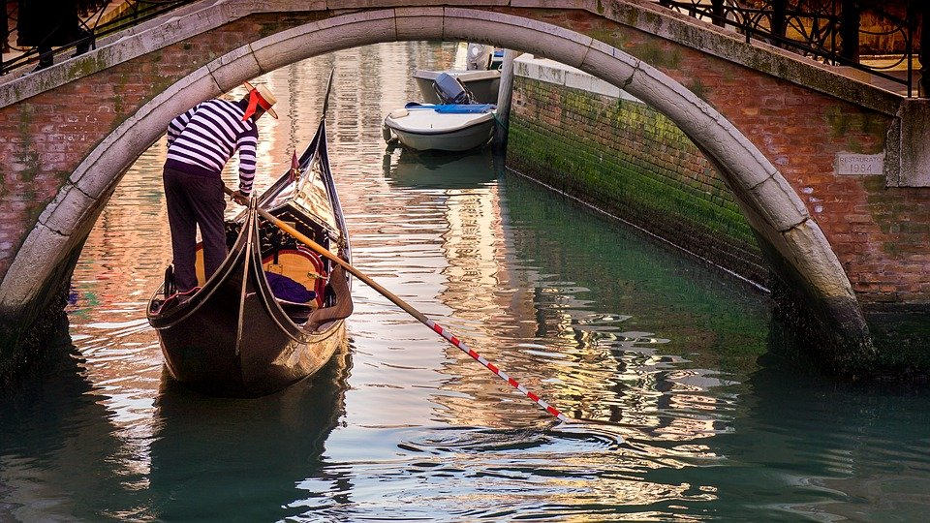

A gondoliere

Slide 10
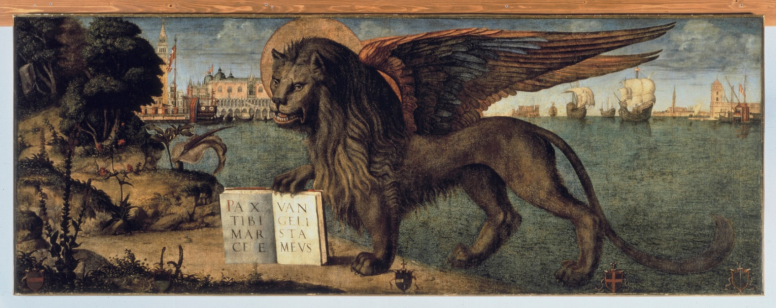
THE WINGED LION OF VENICE
The Lion, representing the evangelist Saint Mark, is the symbol of the city and of the Republic of Venice.
The lion means majesty and power and the book represents the ideas of wisdom and peace.

Slide 11
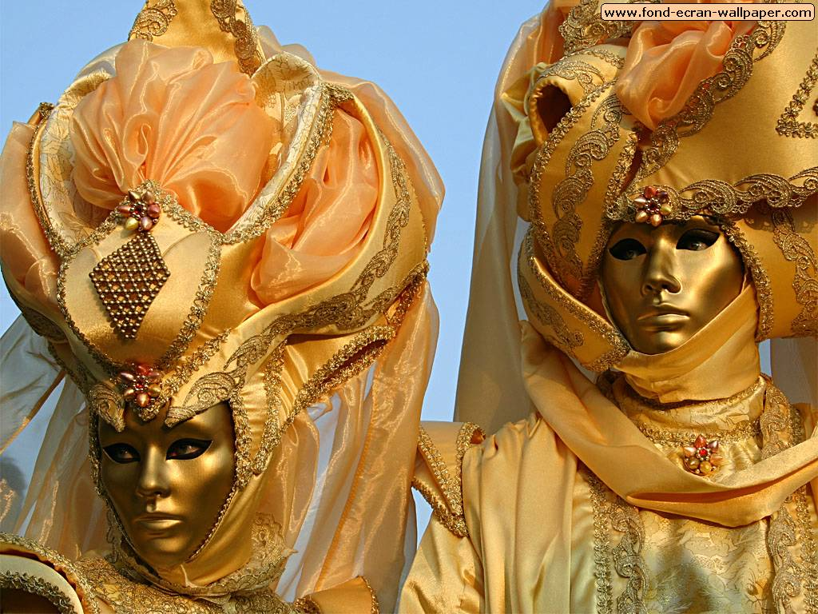

https://youtube.com/watch?v=HVhNni3MjjQ&si=EnSIkaIECMiOmarE
The Carnival of Venice is a festival we celebrate every year.
The Carnival starts around two weeks before Ash Wednesday and ends on Shrove Tuesday (= Martedì Grasso).
The Venice Carnival is famous in all the world!!!

Slide 12
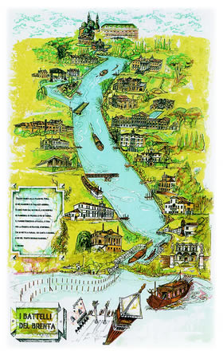
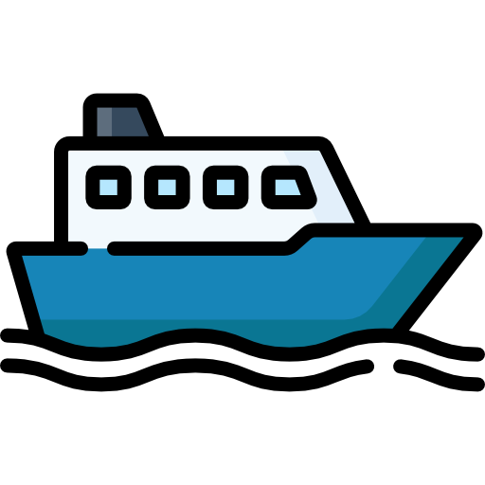
The river
BRENTA

Slide 13
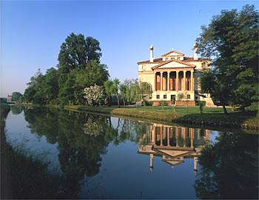
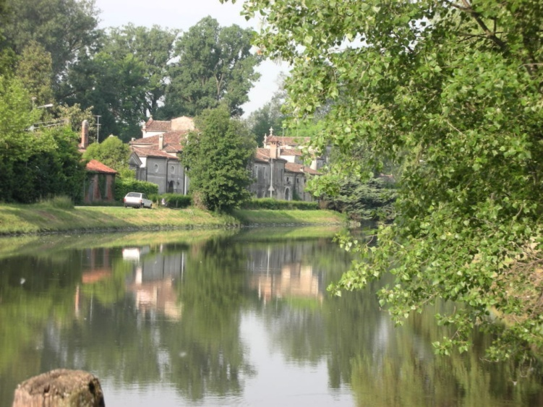
Where we are
Villa Foscari
The River Brenta
Our schools are in Oriago, in an area called Riviera del Brenta.
Brenta is the name of the river – you can go by boat and reach Venice in an hour, if you want.
On its banks there are many beautiful Venetian villas, where in the past the Venetian nobles used to spend their holidays.

Slide 14
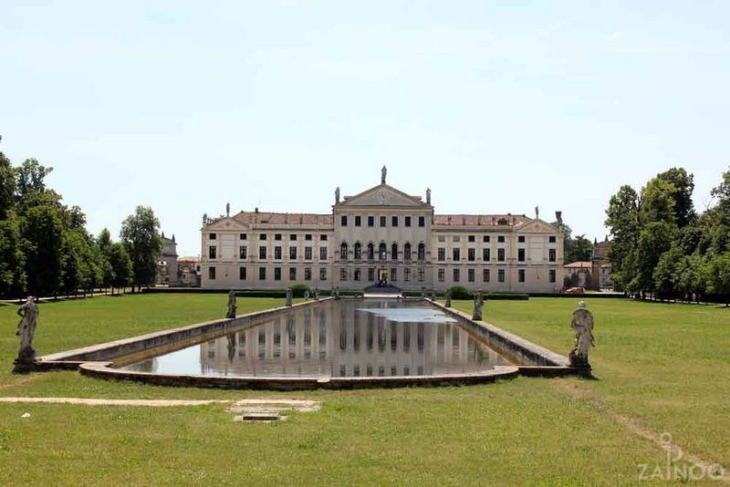
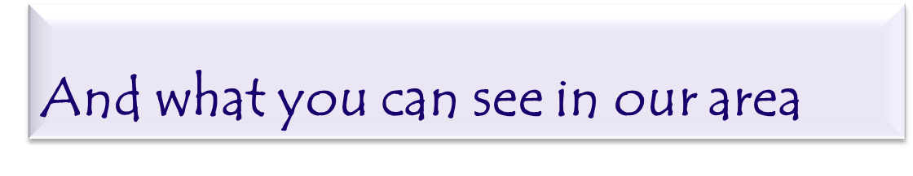
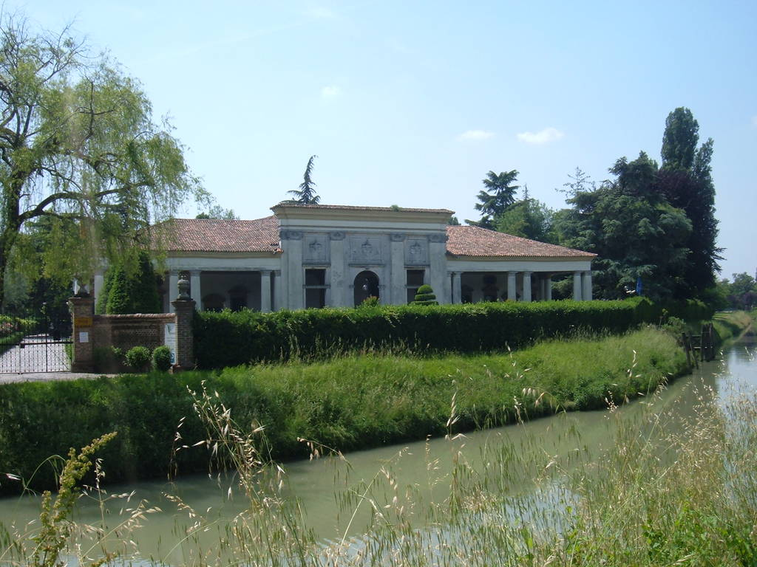
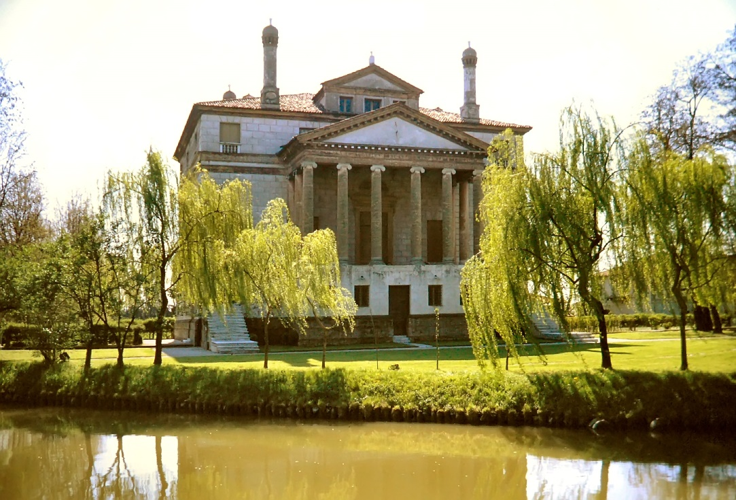
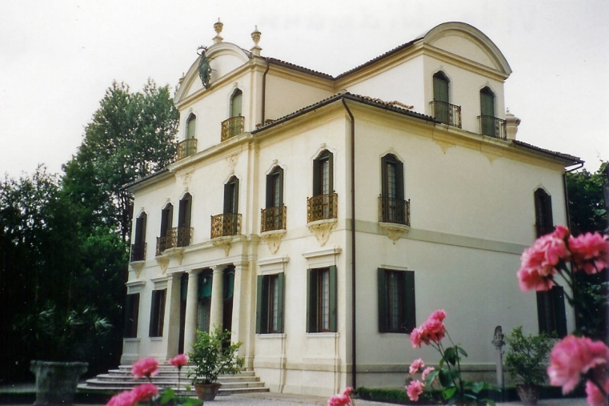

Slide 15
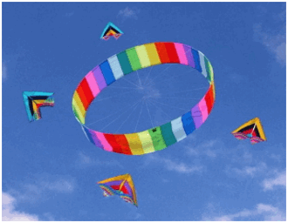

Our school
By education, I mean an all-round drawing out of the best in the child and man-body, mind and spirit.
Mahatma Ghandi
https://www.istitutocomprensivoadelezara.edu.it/wps/

Slide 16
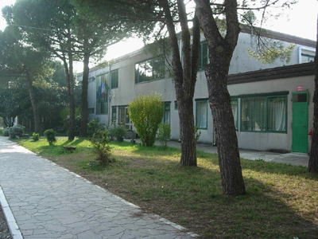
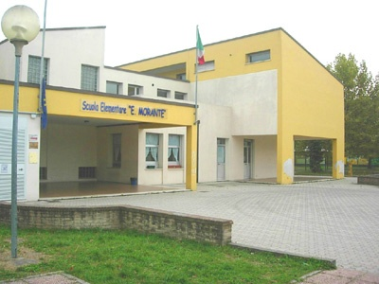
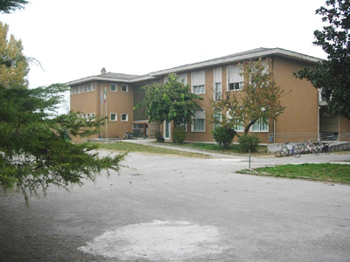
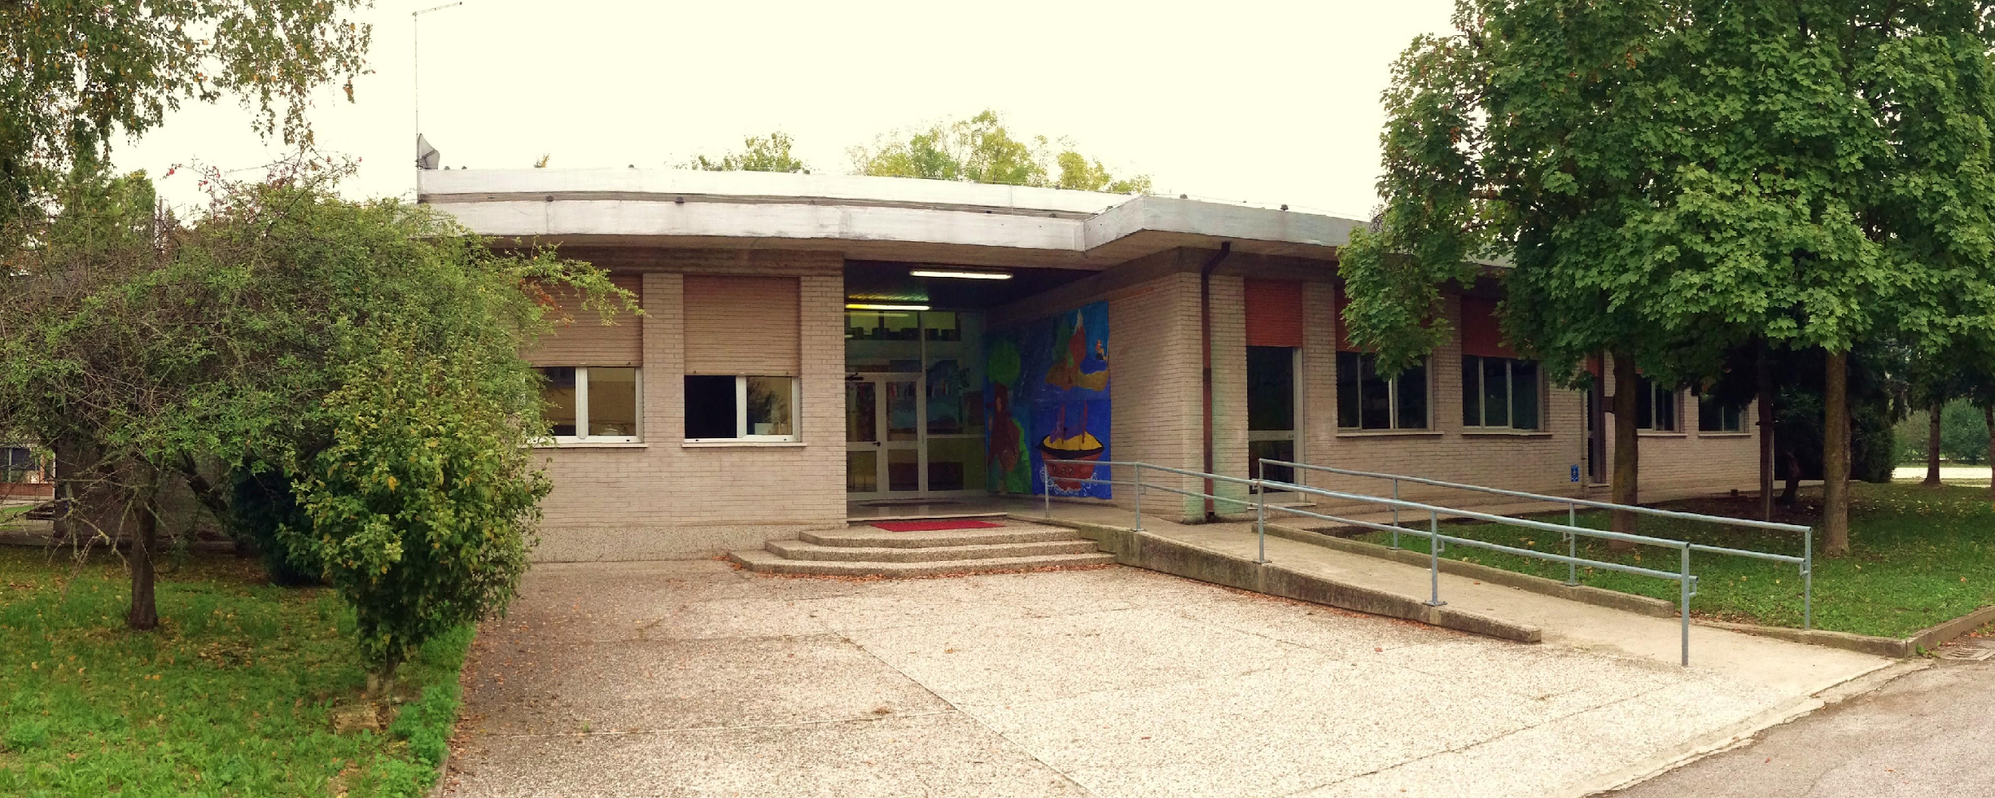
Our Primary schools
“C. Goldoni”
“E. Morante”
“De Amicis»
“G. Parini”

Slide 17
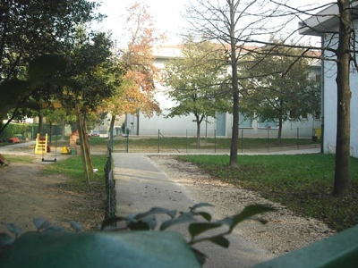
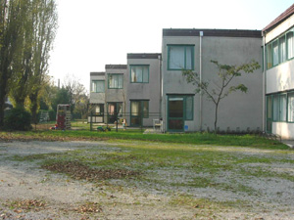
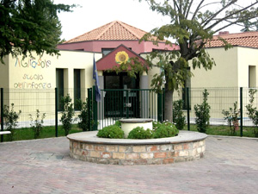
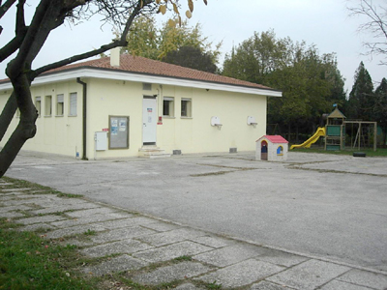
Our Infant schools
Arcobaleno Calvino
Girasole Rodari

Slide 18
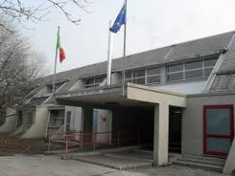
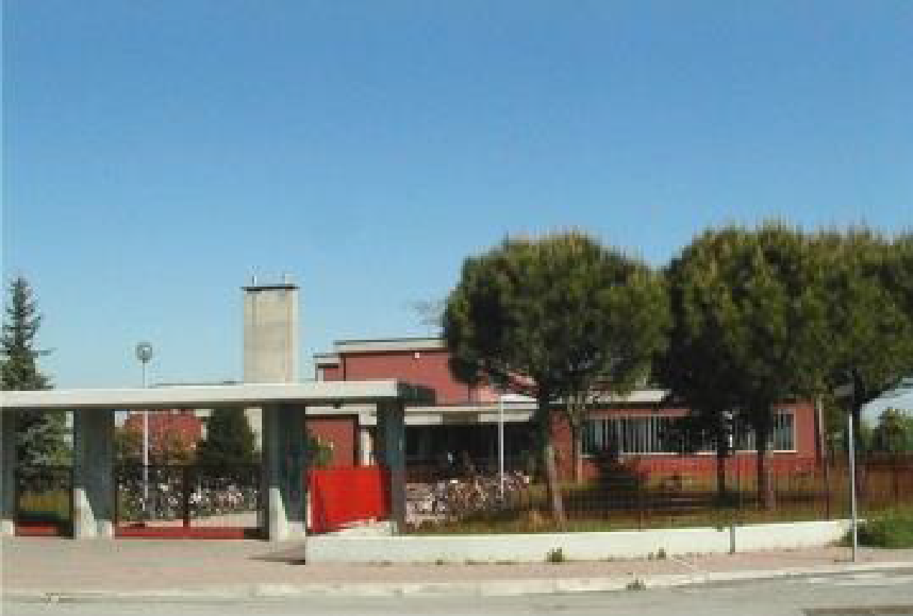
Our middle schools
Alighieri in Oriago di Mira
Petrarca in Borbiago di Mira

Slide 19








Enjoy
The
Erasmus+ Project
«What a wonderful world!» with us !

Slide 20

Thank you
for watching

